Slide 1
ActiveX
present by
Kanokkan & Krittika
Adviser
Ms Wanvimonsri

Slide 2


World Wide Web (WWW)
television
Magazine
up-to-date
always available
World Wide Web

Slide 3
Creating Interactive Content for the World Wide Web
Server-Side Code
ActiveX
Client-Side Code
Java

Slide 4
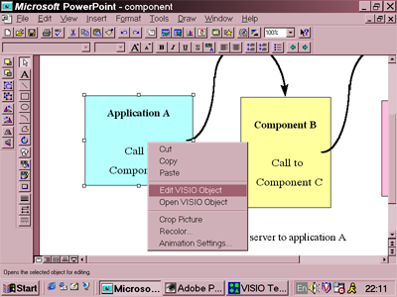
ActiveX
Edit VISIO Object on Microsoft Powerpoint

Slide 5
ActiveX
ActiveX Controls

Slide 6
ActiveX Controls
Advantages
สร้างโดยใช้ tools ที่รู้จัก
ง่ายต่อการ Integrate กับ application อื่น ๆ
ง่ายต่อการใช้งานบน Containers
Disadvantages
ยังไม่ถูก support ใน Netscape
ยังไม่ถูก support บน UNIX platform

Slide 7
ActiveX
ActiveX Controls
ActiveX Documents
ActiveX Components

Slide 8
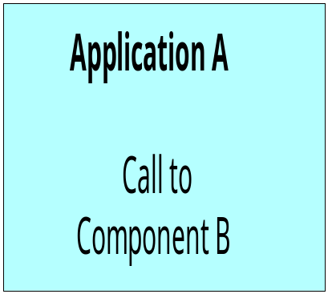
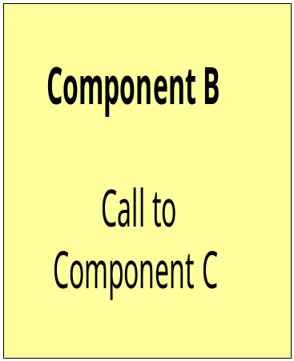
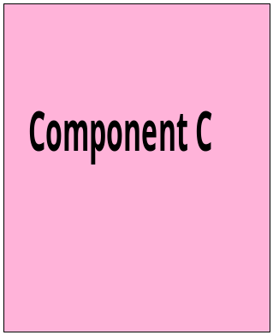
ActiveX Components
server to application A
and client to application C

Slide 9
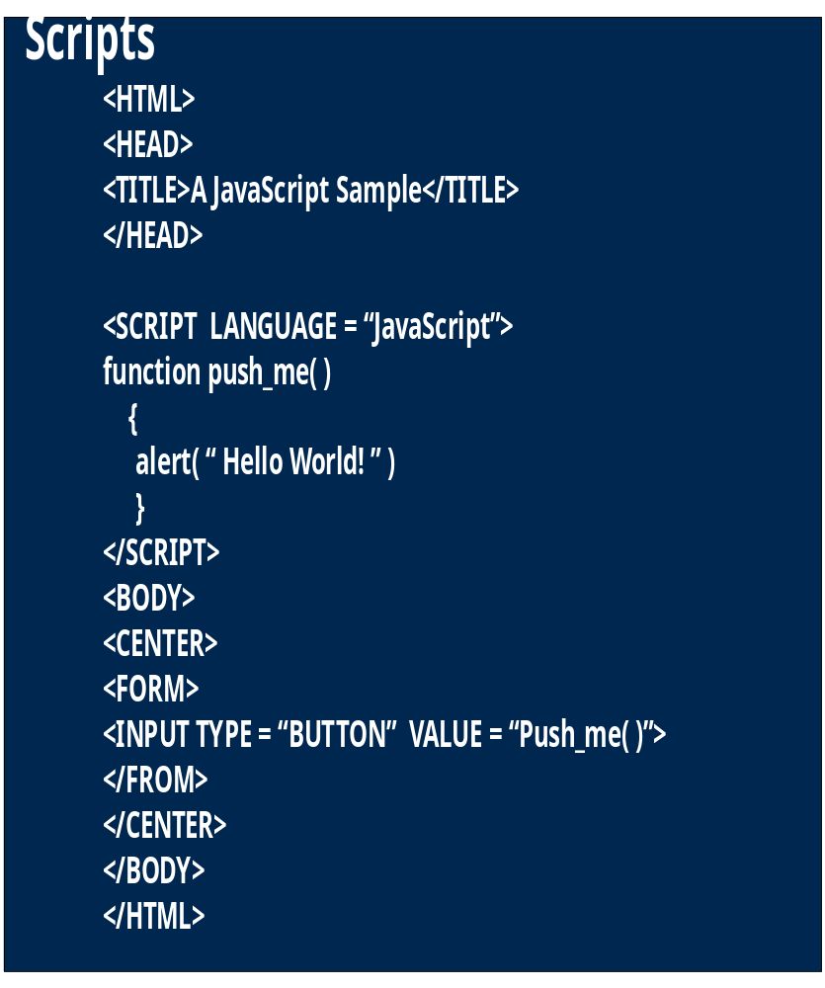
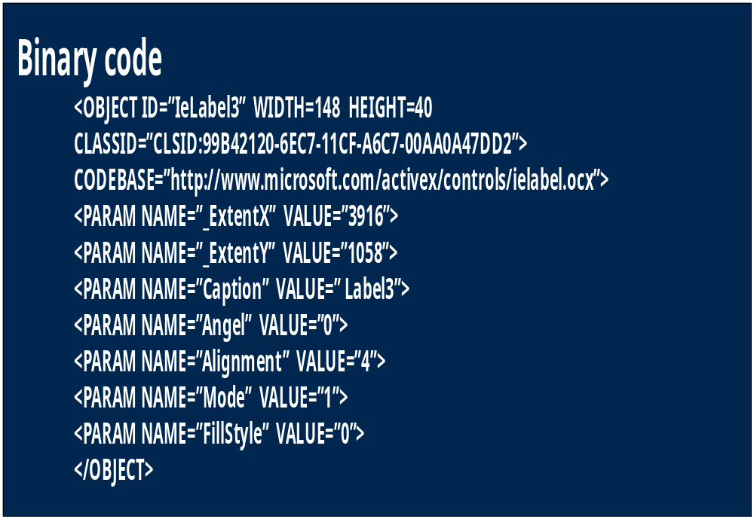
Two basic types of client-side code

Slide 10
Putting Interactive Code on Internet Information Server (IIS)
Common Gateway Interface (CGI)

Slide 11

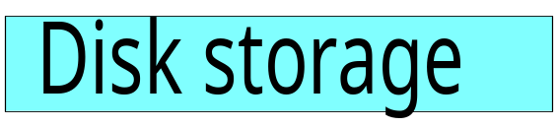



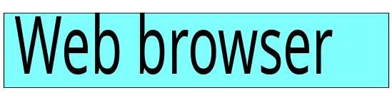


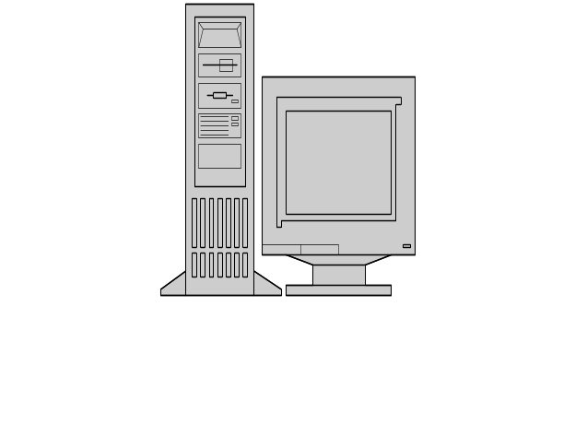
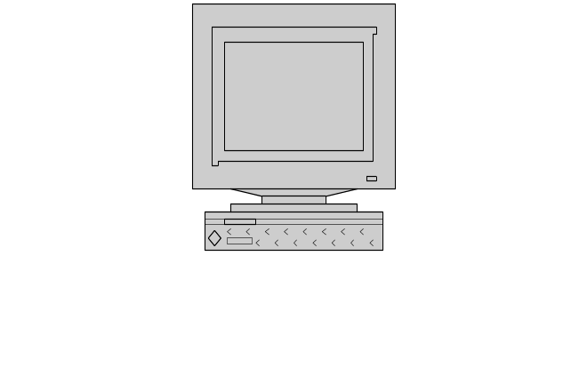
Common Gateway Interface
Client
Server

Slide 12
Putting Interactive Code
on Internet Information Server (IIS)
Common Gateway Interface (CGI)
Internet Server Application Programming Interface (ISAPI)
- ISAPI fiter
- ISAPI extensions

Slide 13

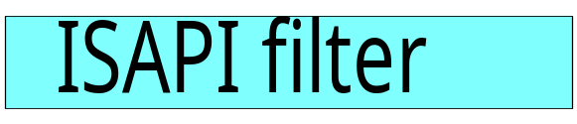
ISAPI filter model
Client
Server

Slide 14

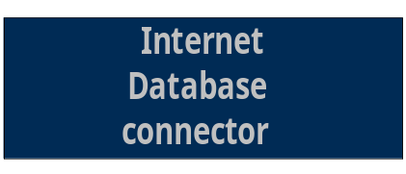



ISAPI extension model
Client
Server
Internet Database Connector (IDC)

Slide 15
ISAPI and CGI have different approaches to use of process space
CGI
ISAPI
System Process
Space
Web Server
Process Space
CGI App
CGI APP
System Process
Space
Web Server
Process Space
ISAPI App
ISAPI App

Slide 16
Putting Interactive Code
on Internet Information Server (IIS)
Common Gateway Interface (CGI)
Internet Server Application Programming Interface (ISAPI)
- ISAPI fiter
- ISAPI extensions
Active Server Pages (ASP)

Slide 17
Ease of development vs. richness of content in Web applications
Hard
CGI Scripts,
ISAPI DLL’s
Ease of
Development
ActiveX Server
Pages Side Scripting
HTML
Easy
Static
Dynamic
Types of Web Content

